Slide 1
Title-IOT Based Patient Monitoring System Using Nodemcu Esp8266
Project Members- Ganesh Kavale
Roll No- 32419,32423
Batch –M8

Slide 2
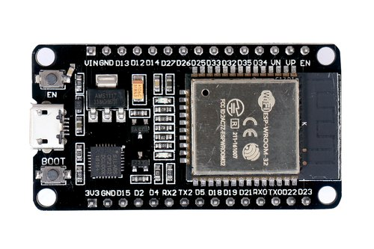
Specifications
Our project contains a Microcontroller/communication module named Nodemcu ESP8266
Specially Designed looking at covid prospective for distance maintaining
Use of Software Named Blynk/THINK SPEAK and AIP Code for WIRELESS communication for Nodemcu ESP8266
Also as it specifies the name patient monitoring we are also going to use BPM sensor and LM35 Temperature Sensor(optional)

Slide 3
Outcomes
Graph Including the BPM on the software
Also the record on Serial Monitor
Monitoring any patient from anywhere
Use of a wireless network and AIP key

Slide 4
Hardware/Software Requirements
Max 30100 pulse oximeter
Nodemcu ESP8266
Bpm monitoring sensor
Zero Pcb
Breadboard
Jumper cables
Oled Display
Arduino Uno IDE
Think Speak
Circuito.io
Proteus 8
Blynk app

Slide 5
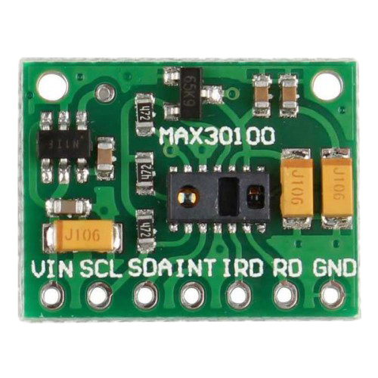
Project brief description
Working of Nodemcu-It performs the task of a microcontroller as well as it also works as Communication module to have wholesome communication all over the bandwidth available.
Working of Max30100 –The Oxygenated blood absorbs more infrared light and passes more red light. But, Deoxygenated blood absorbs red light and passes more infrared light. Basically, the MAX30100 sensor reads the absorption levels for both light sources and stores them in a buffer that can be read via I2C pins

Slide 6
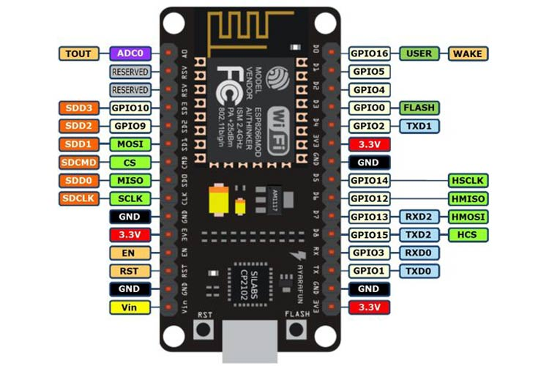
Schematic Of NodemcuEsp8266

Slide 7
Project Timeline
Week 1- Creating synopsis and making circuit diagram / block diagram and also all required data for presenting
Week 2-Selecting a proper software for interfacing virtually also for the coding
Week3- Assembling the Project with study of all data sheets virtually
Week4- Creating the hardware schematic and assembling the components of the breadboard or zero PCB first
Week5-Checking testing of the project on various platforms and Real Time Working
Week6-Creating of PCB design for the schematic
Week7- Creation of Project Report and Making study of how this project can be made used for the future scope

Slide 8
Block Diagram
Also study of Wifi Authentication is done to use Esp8266
NodemcuEsp8266
Oled Display
Thinkspeak ide
I/p
O/P
MAX30100
Blynk App

Slide 9
Literature Survey
NodeMCU is an open source firmware for which open source board designs are available. The name "NodeMCU" combines "node" and "MCU" (Micro Controller Unit).NodeMCU strictly speaking refers to the firmware rather than the associated development kits.
Both the firmware and prototyping board designs are open source.
The firmware uses the Lua scripting language. The firmware is based on the eLua project, and built on the Espressif Non-OS SDK for ESP8266. It uses many open source projects, such as lua-cjson and SPIFFS. Due to resource constraints, users need to select the modules relevant for their project and build a firmware tailored to their needs. Support for the 32-bit ESP32 has also been implemented.

Slide 10
Applications
Monitoring patients during the time of Quarantine or Having Covid symptoms from anywhere
Accuracy of Spo2 And BPM by Max30100 sensor as it is highly rated
Avoiding Social contact with the patient will reduce the spread of covid(By taking covid platform under consideration
No lag in data transmission as Esp8266 proves to be one of the finest of all

Slide 11


